Slide 1


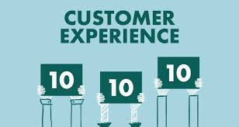
A Project Presentation on:
Data Analysis of Customer Retention in the E-commerce Sector
Submitted by:
A Kishore Kumar
Batch No.:
Internship_33

Slide 2
OUTLINE:
Overview.
What is customer Retention?
Need of customer retention.
Problem Statement.
Problem Understanding.
Data Analysis on Customer Retention dataset.
Conclusion.

Slide 3
Overview:
In this particular presentation we will be looking on:
How to analyze the dataset of Customer Retention.
Find out the real customer attitude with respect to individual factors.
Analyzing the E-commerce site to improve the customer retention rate of their business.
Investigate the concrete influential factors of customer retention in an E-commerce market context.
Retention Strategies of E-Commerce Business.
What are the criterion to achieve Customer Retention.
Areas for further improvement.
Strong Area according to feedback by customer.
Overall analysis on the problem.

Slide 4
2. What is Customer Retention?
Businesses work hard to attract customers through a mix of marketing, social media and brand strategies.
Businesses have invested a lot of time and effort (and probably money) gaining the customers’ trust. It only makes sense if they hold on to them.
That is where a strong focus on customer retention comes in handy. To improve customer retention, Businesses have to look at their entire customer experience.
The customer experience involves everything customers think and feel when they encounter their brand.
Thus, “Customer Retention” refers to a company's ability to turn customers into repeat buyers and prevent them from switching to a competitor.
It indicates whether your product and the quality of your service please your existing customers.
It's also the lifeblood of most subscription-based companies and service providers.

Slide 5
3. Need of Customer Retention
According to many researches, businesses found that the most valuable customer is the repeat customers. The high cost is to be invested to acquire new customers rather than retaining the old customers.
Less spending on customer acquisition : Acquiring a new customer can be up to five times more expensive than retaining an existing one.
Increased profits : An increase in client retention by 5% can enhance profits by over 25% .
Improved online reputation : Over 37% of customers will only post online reviews if they are “extremely satisfied”.
Positive Reviews : The longer customers stay with a company, the more business, positive reviews, and they bring word of mouth advertising.
Also, many customers relationship goes unprofitable because the new customer only stay in the initial stage of the transactions.
So, for the E-commerce business customer retention is one of the key paths to profit. The businesses should have a clear strategy of customer retention.

Slide 6
4. Problem Statement
Customer satisfaction has emerged as one of the most important factors that guarantee the success of online store; it has been posited as a key stimulant of purchase, repurchase intentions and customer loyalty.
Five major factors that contributed to the success of an e-commerce store have been identified as: service quality, system quality, information quality, trust and net benefit.
The research furthermore investigated the factors that influence the online customers repeat purchase intention. The combination of both utilitarian value and hedonistic values are needed to affect the repeat purchase intention (loyalty) positively.
Now the competitor is just a click away, the competition has now became more lethal and direct.
In the modern time the difference of products is less and less.
Its hard for the businesses to get to know who is their true customer and what kind of the customer is the most valuable one.

Slide 7
5. Problem Understanding
The new trends of E-commerce industry are to import the customer relationship management concept to understand better of their customers.
The goal is to build a long-lasting relationship between the brand and consumers.
Once a customer becomes loyal to their brand, not only he will buy more than a normal customer but he’ll spread good words about the business, increase the reputation.
Thus in this particular problem solution I have used all my analysation skills to solve the problem of customer retention.
The better information transparency of online business improves the possibility that the customer could find the right product with good price.

Slide 8
6. Data Analysis on Customer Retention dataset:
The steps to analyze & report on Customer Retention dataset are as follows:
Hardware & Software Used.
Data Sources and their size.
Data Integrity Check.
Statistical Analysis of Dataset.
Exploratory Data Analysis (E.D.A).

Slide 9
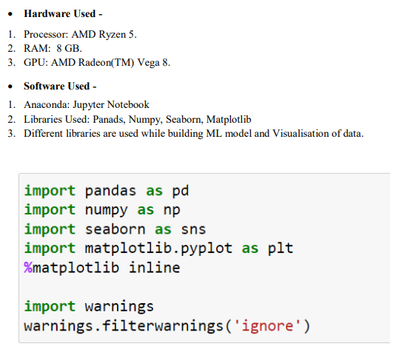
1. Hardware & Software Used.

Slide 10
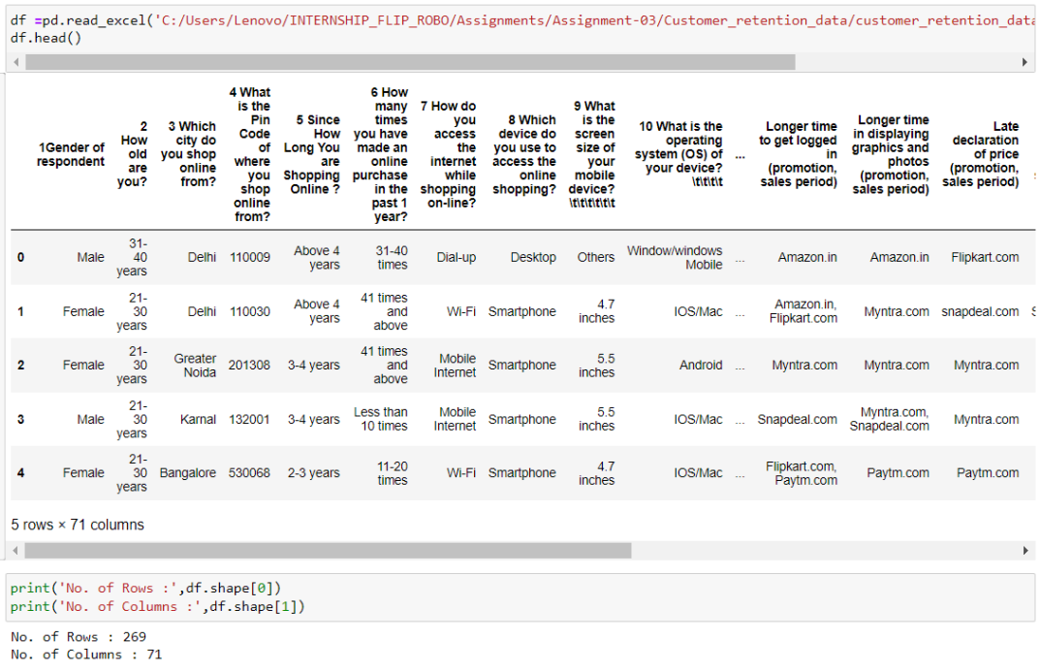
2. Data Sources and their size:
The Dataset contain 71 columns with 269 rows. Out of which 1 feature with int datatypes and rest are with object datatypes.

Slide 11
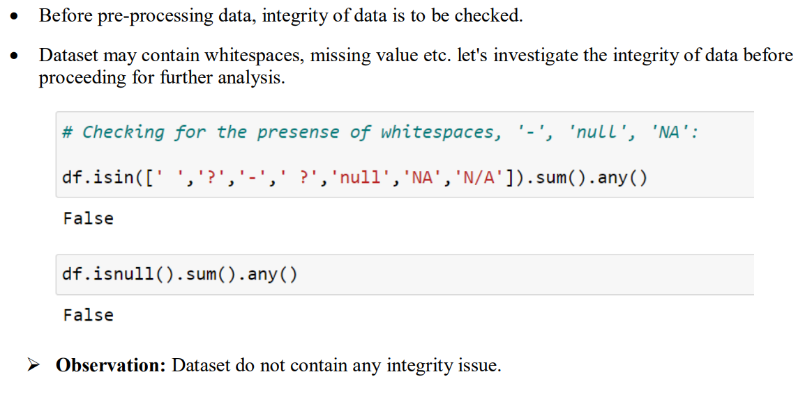
3. Data Integrity Check

Slide 12
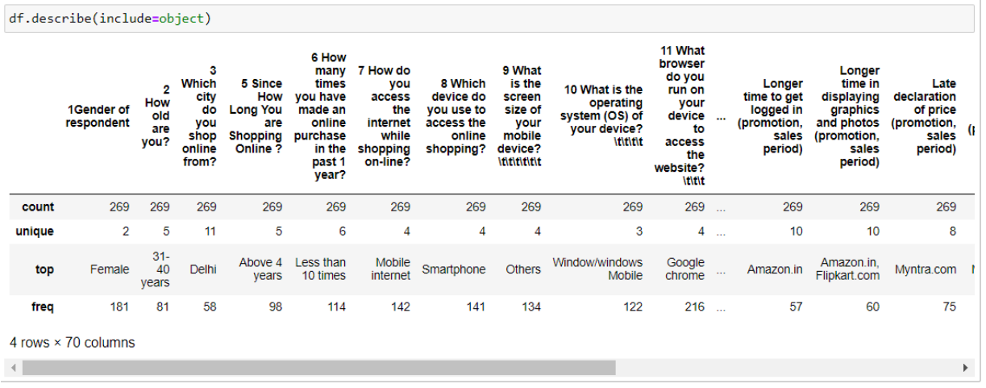
4. Statistical Analysis of Dataset:
Statistical analysis is a data analysis tool that helps draw meaningful conclusions from raw and unstructured data.
Conducting descriptive statistics (i.e., mean, standard deviation, frequency and percent, as appropriate)

Slide 13
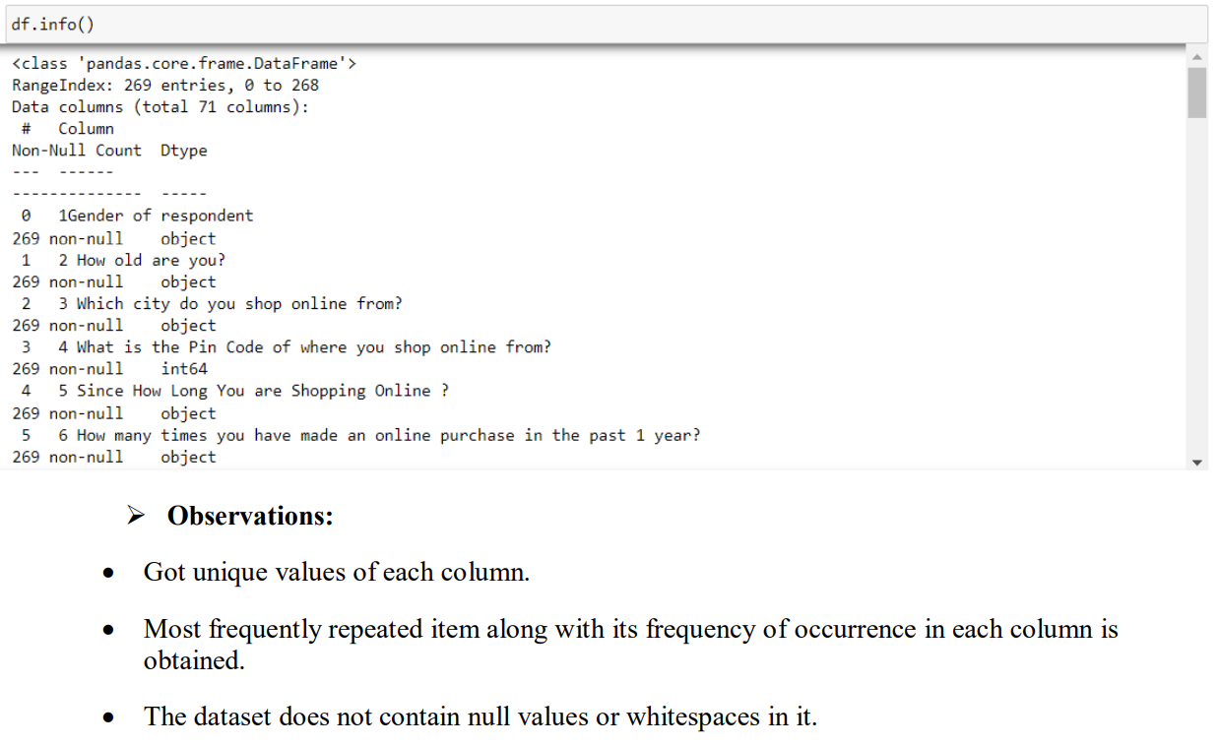

Slide 14
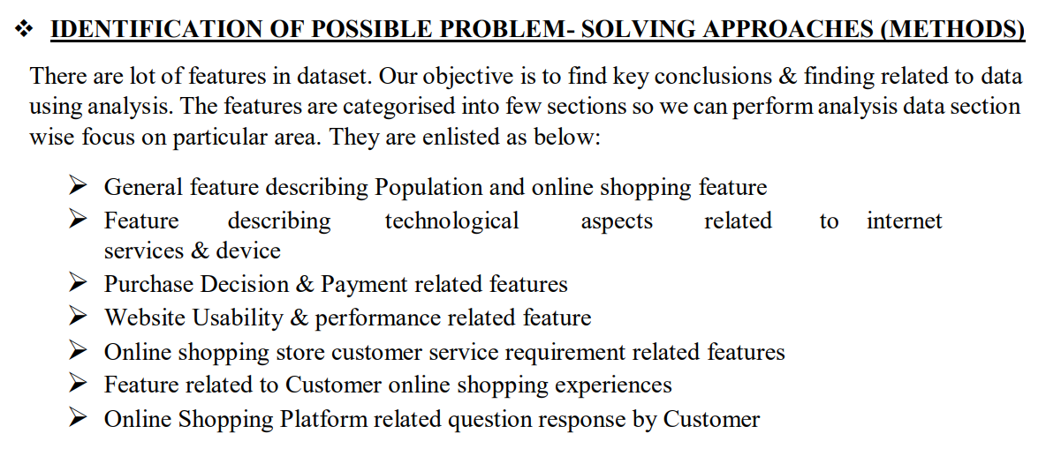
5. Exploratory Data Analysis (E.D.A):

Slide 15
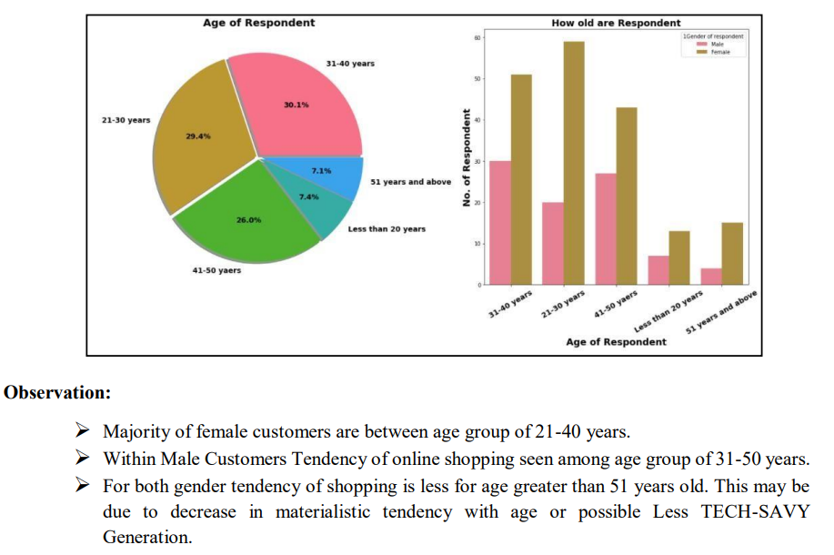
I. General feature describing Population and online shopping

Slide 16
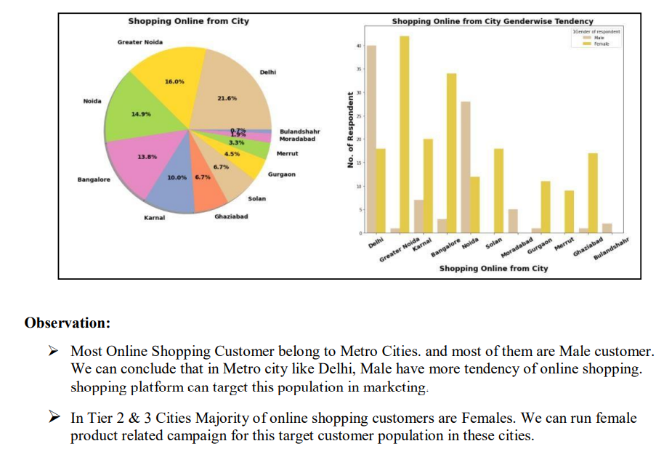

Slide 17
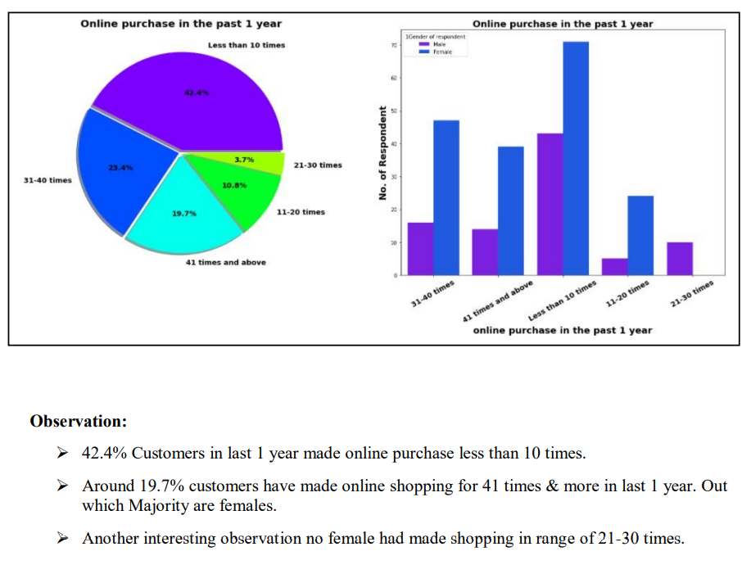

Slide 18
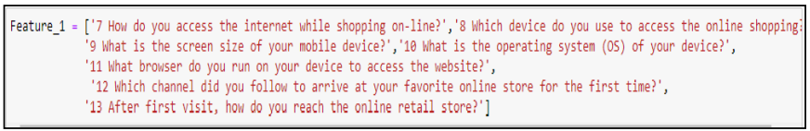
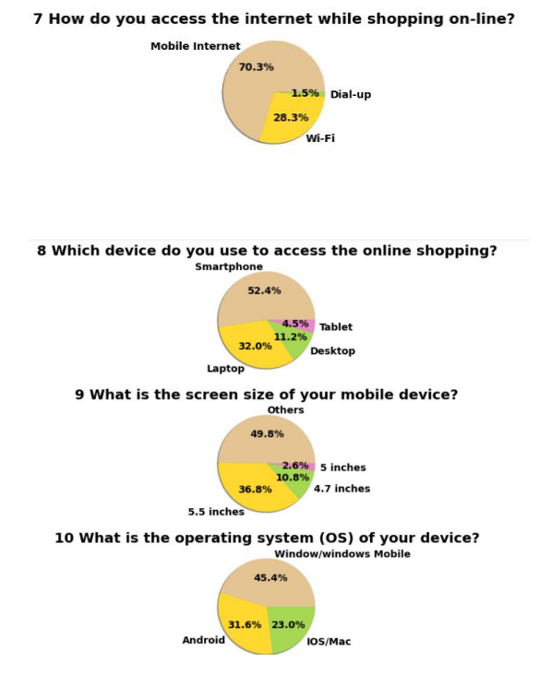
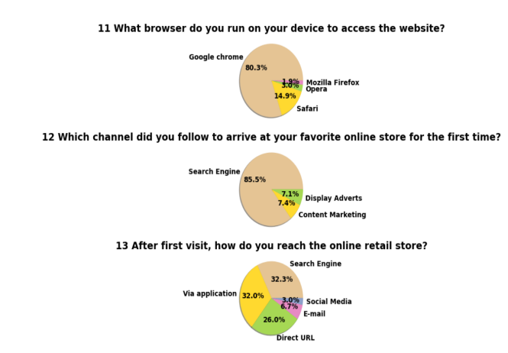
II. Exploring feature describing technological aspects related to internet services & device

Slide 19
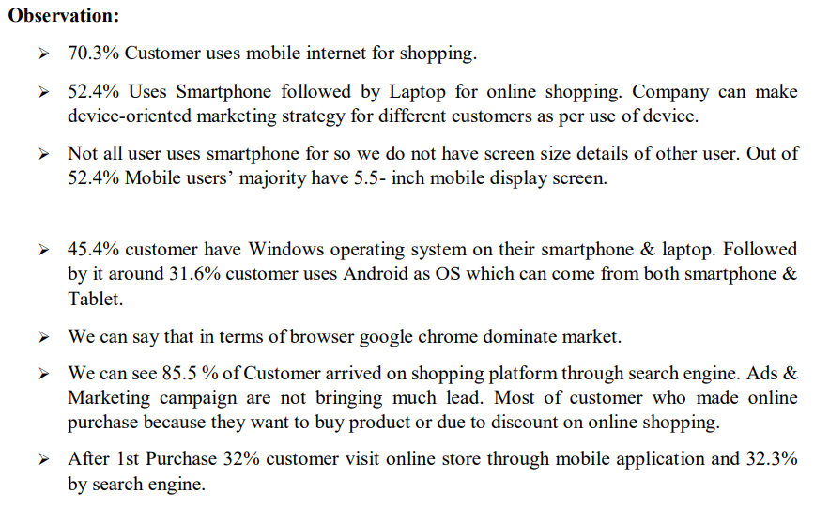

Slide 20
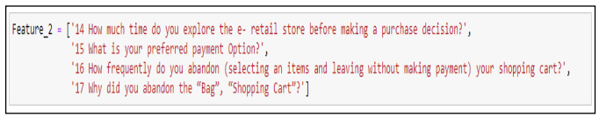
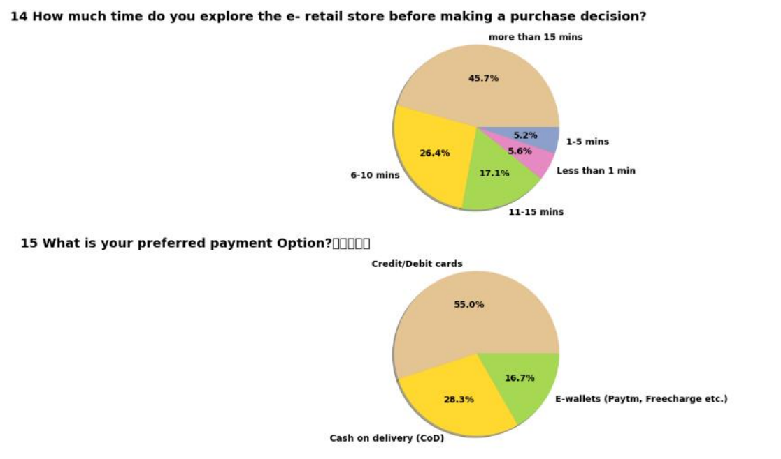
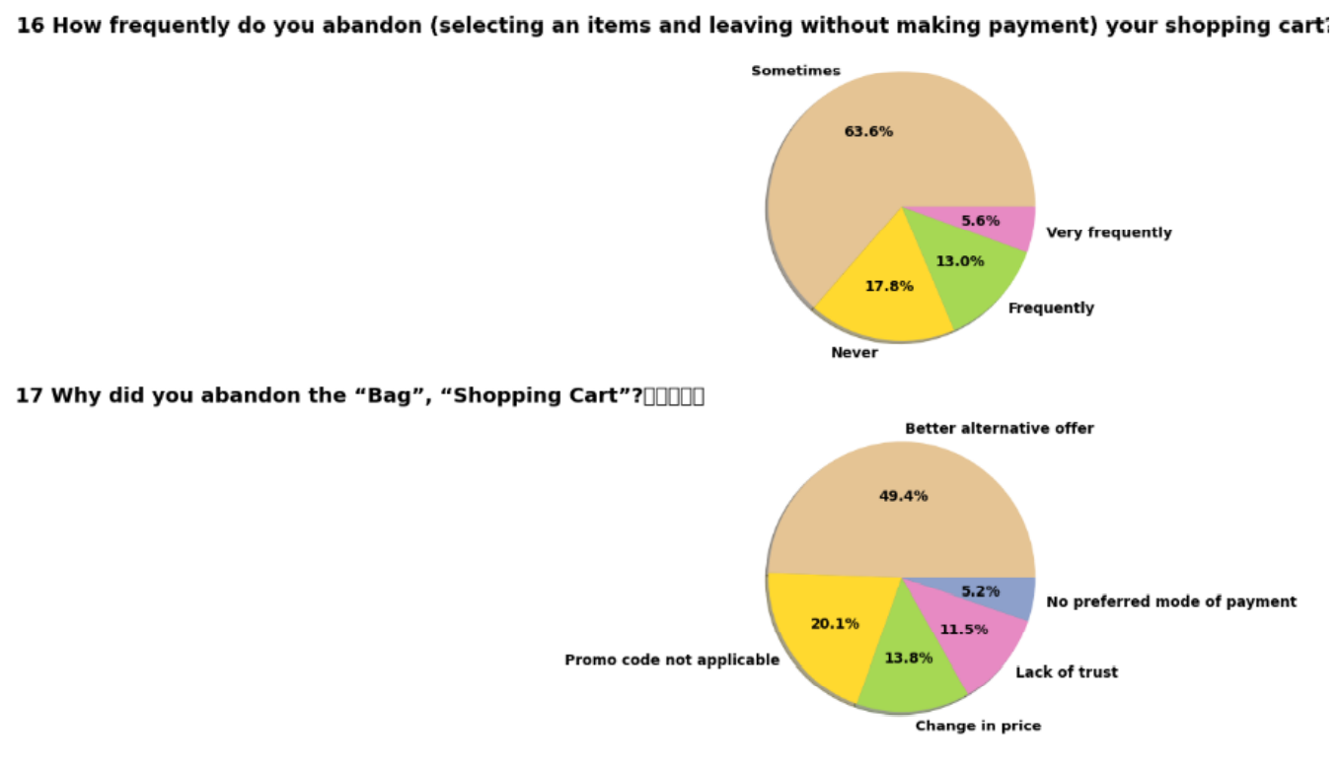
III. Exploring Purchase Decision & Payment related features

Slide 21
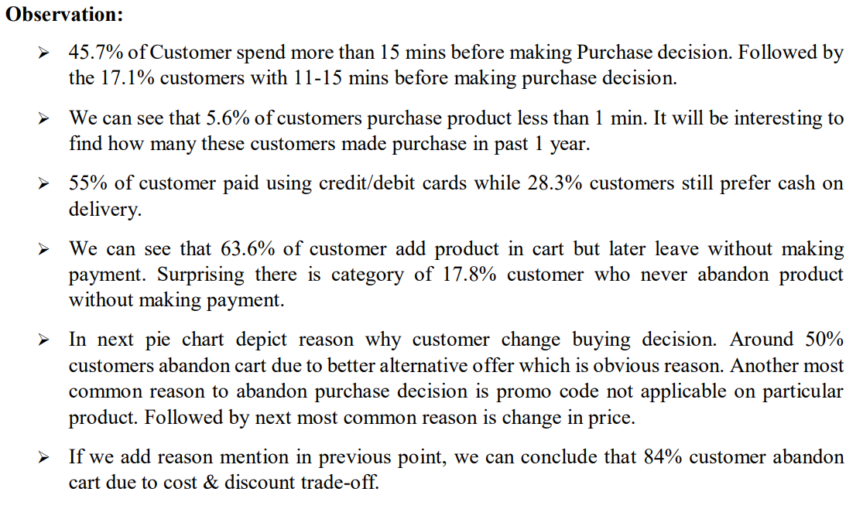

Slide 22
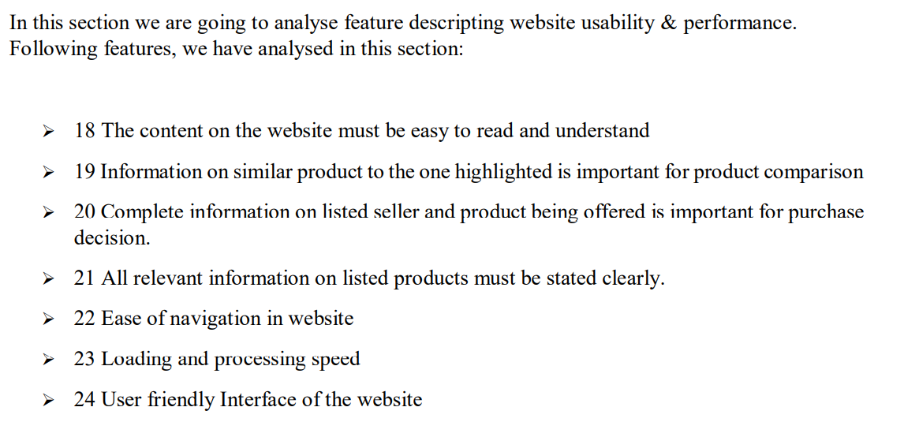
IV. Exploration Of Website Usability & Performance Related Feature

Slide 23
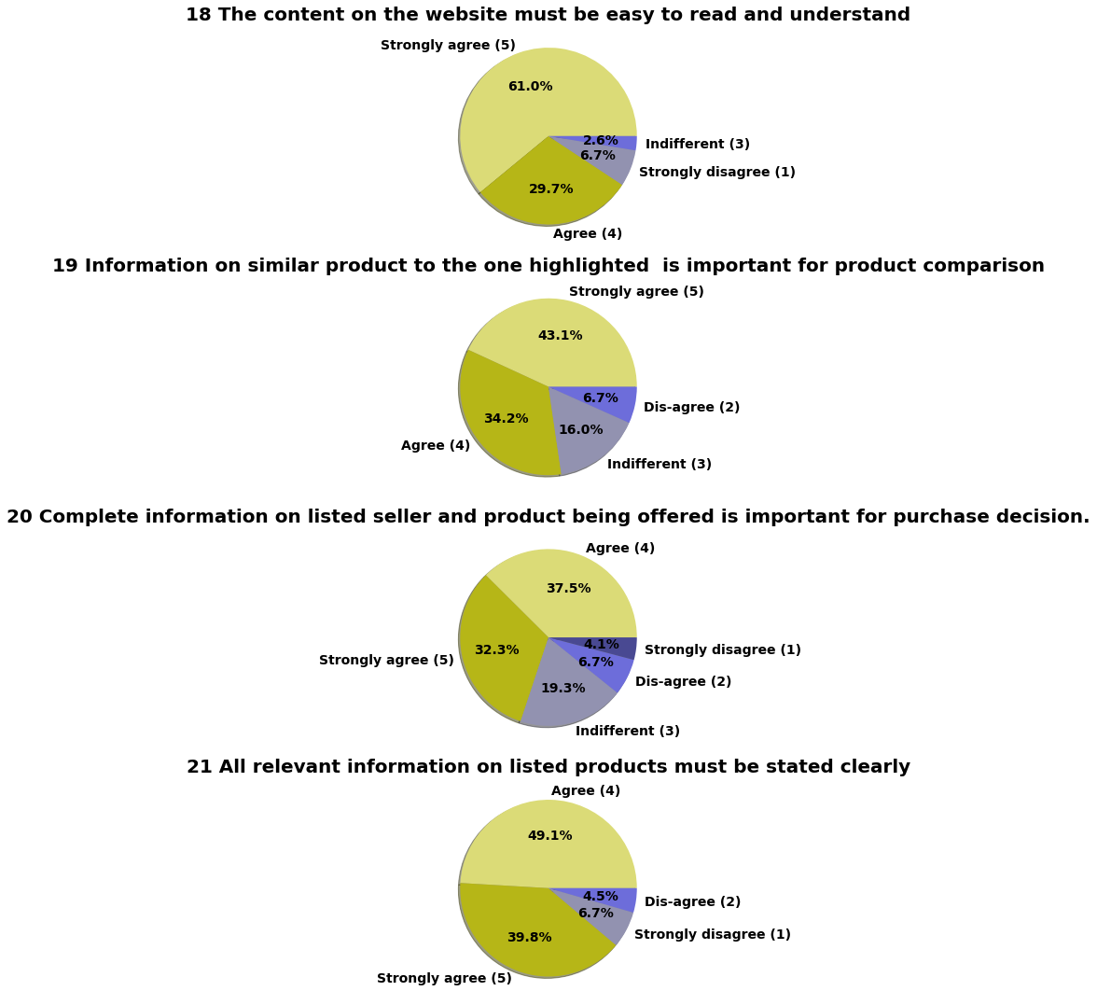
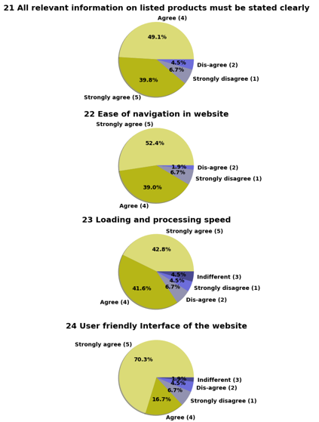

Slide 24
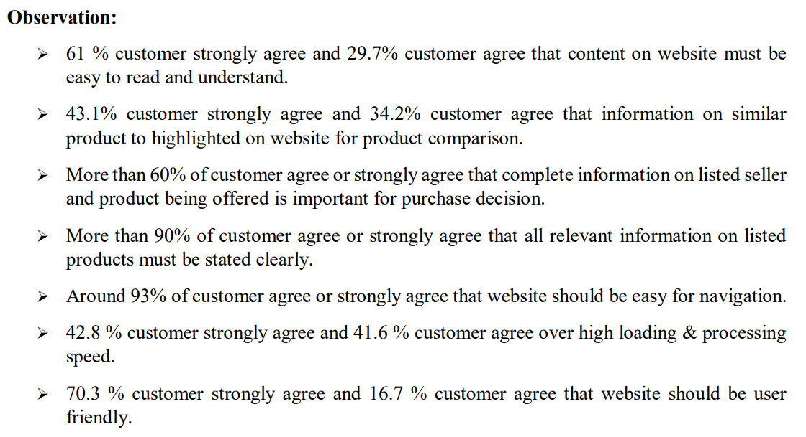

Slide 25
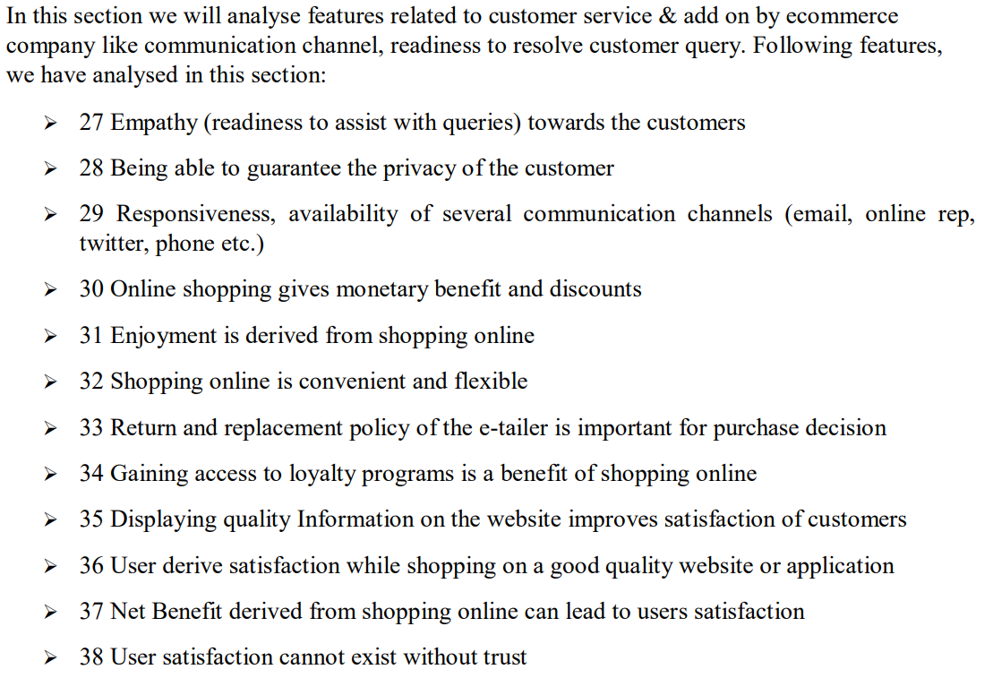
V. Exploration Of Online Shopping Store Customer Service Requirement Related Features

Slide 26
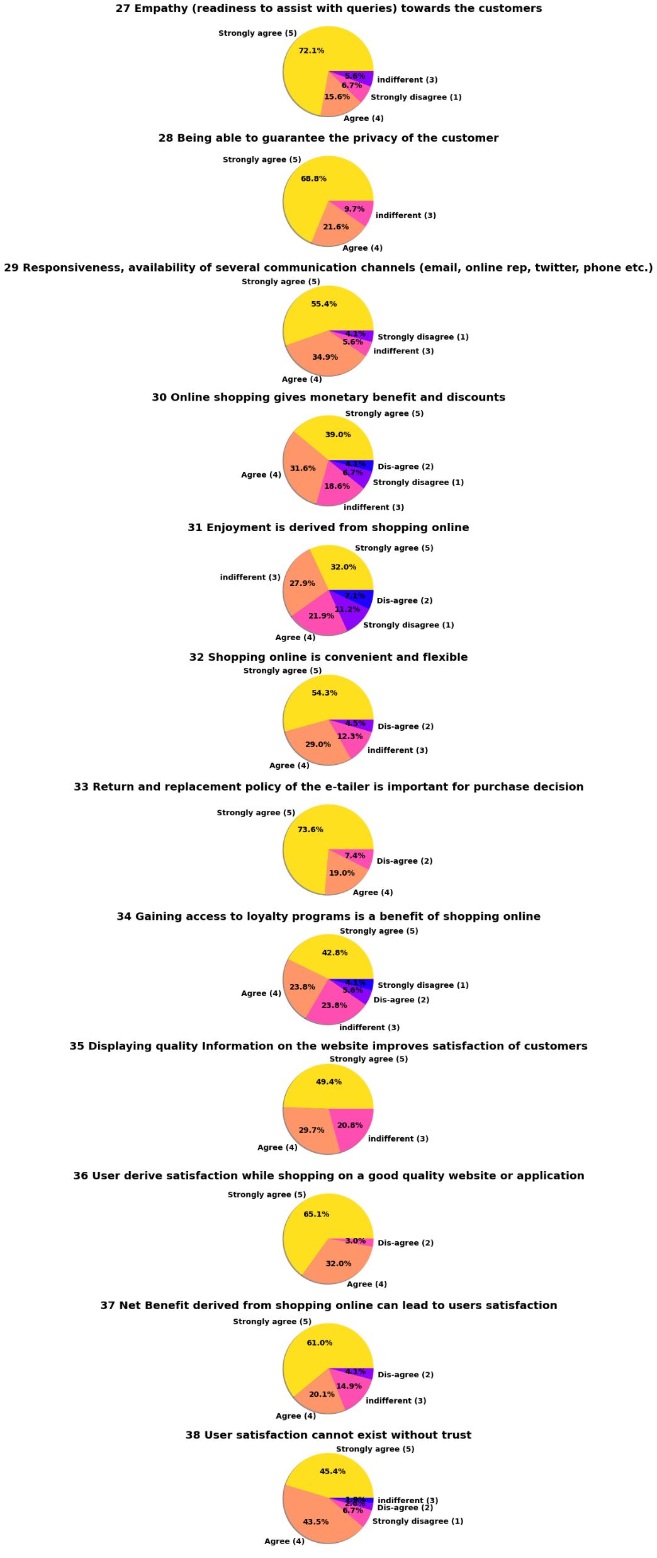
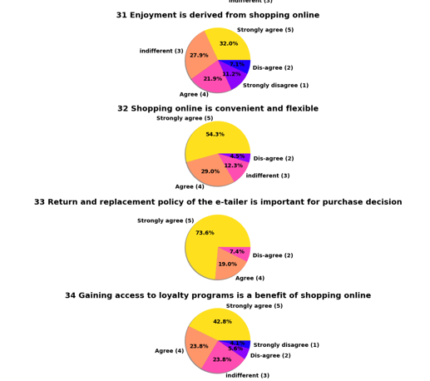

Slide 27
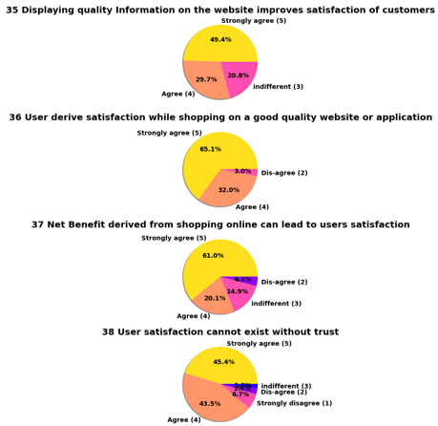
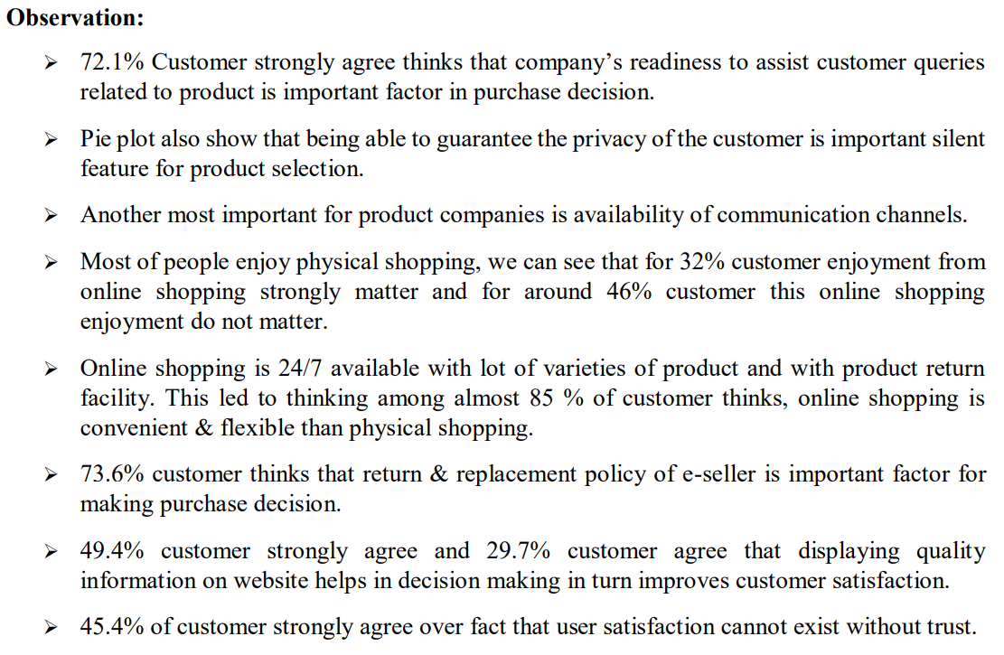

Slide 28
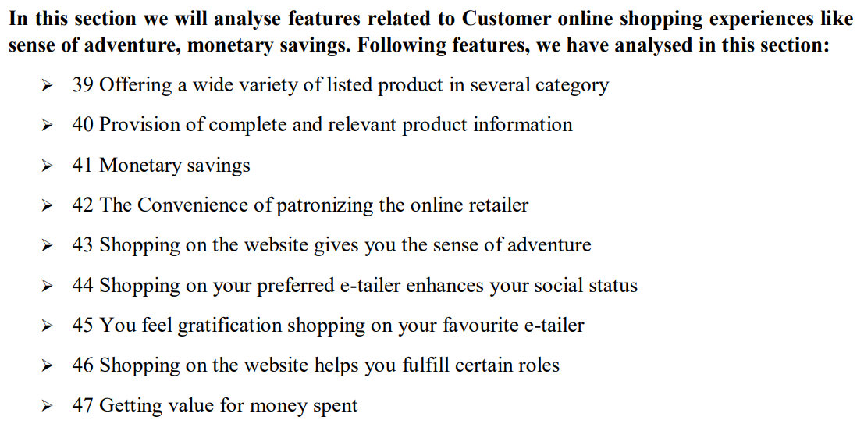
VI. Exploring Feature Related to Customer Online Shopping Experiences

Slide 29
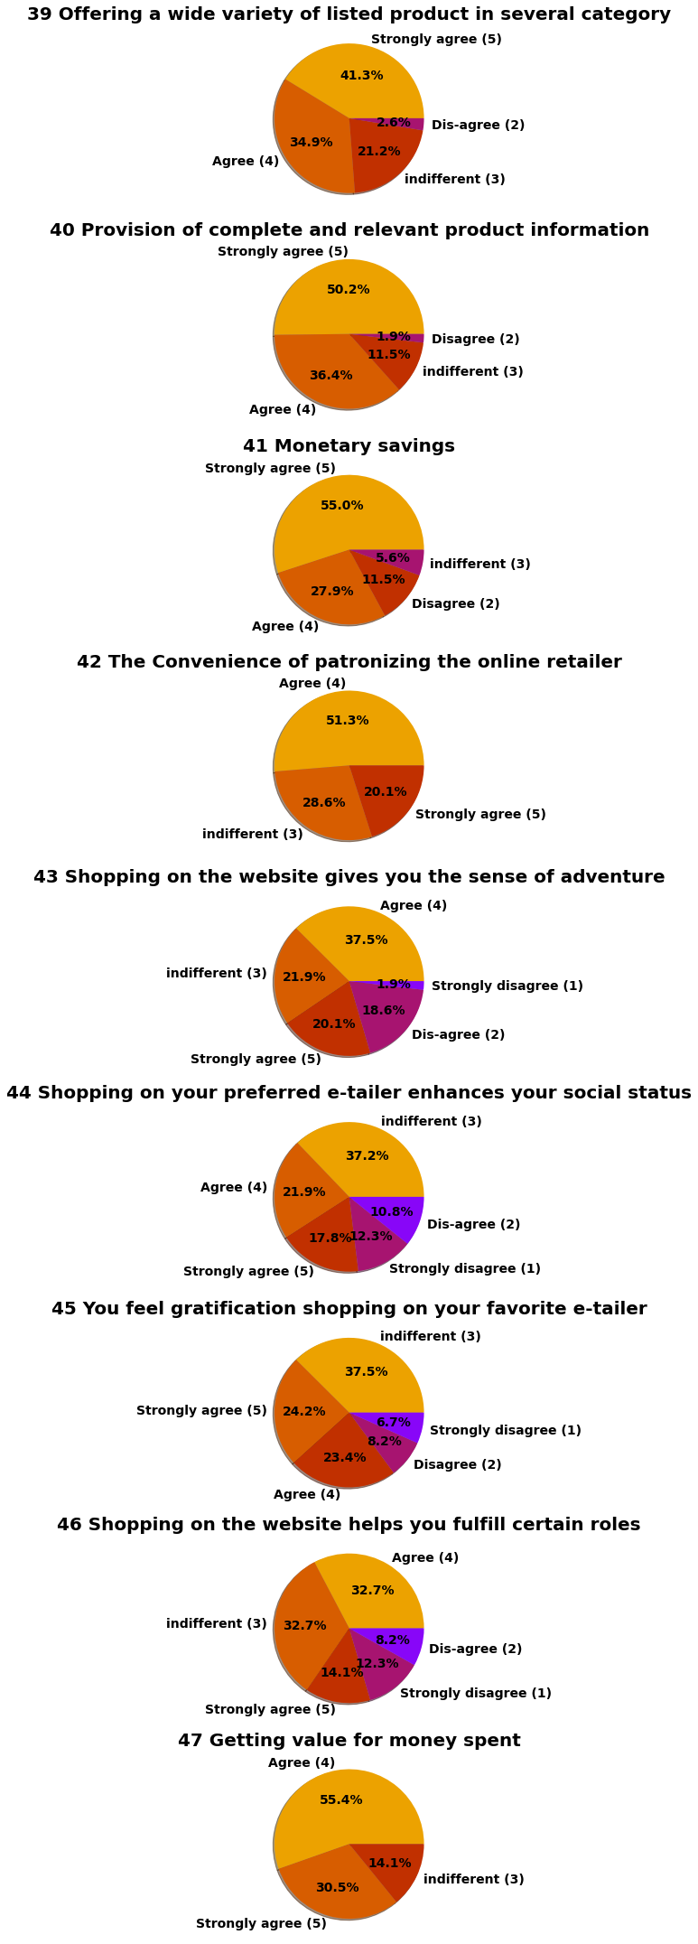
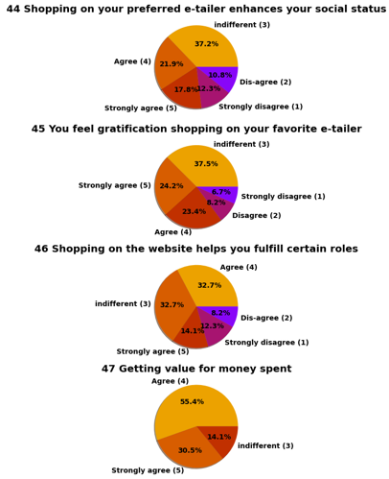

Slide 30
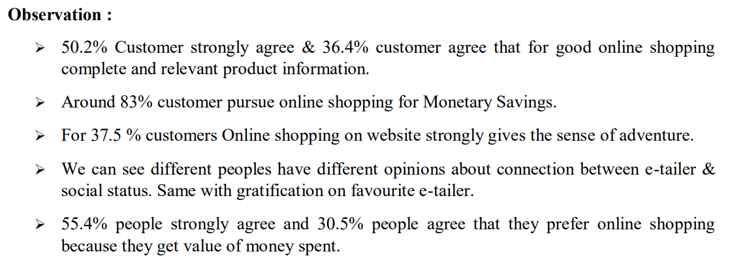

Slide 31
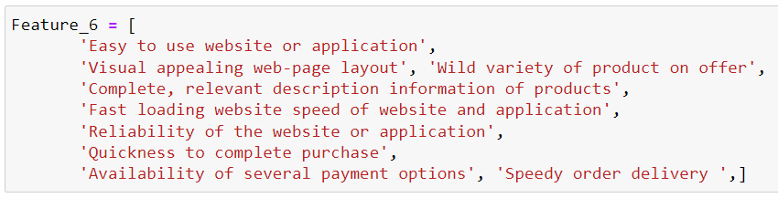
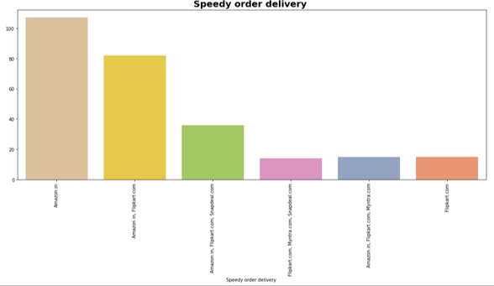
VII. Exploring Opinion on Online Shopping Platform Websites by Customer
In this section we will analyze features related to website or application like performance, web layout.
Following features, we have analyzed in this section:

Slide 32
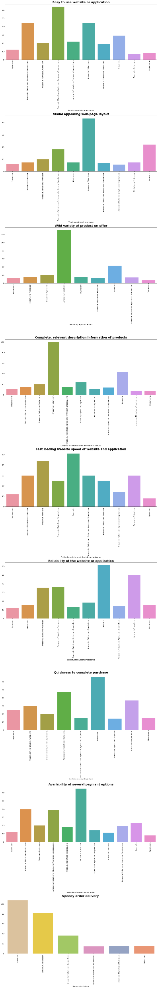
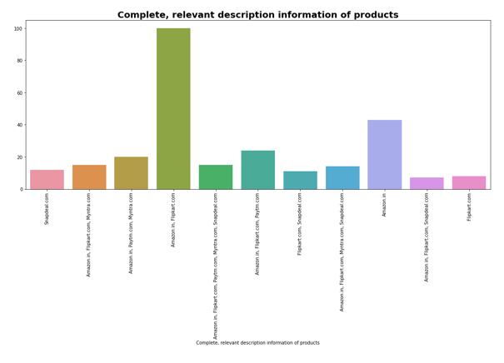
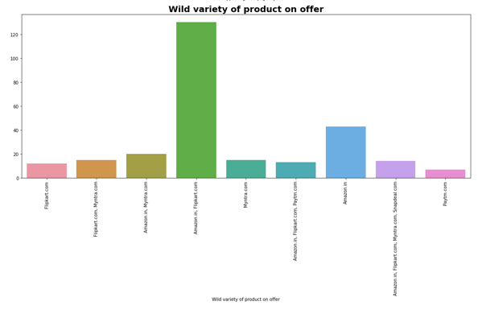

Slide 33
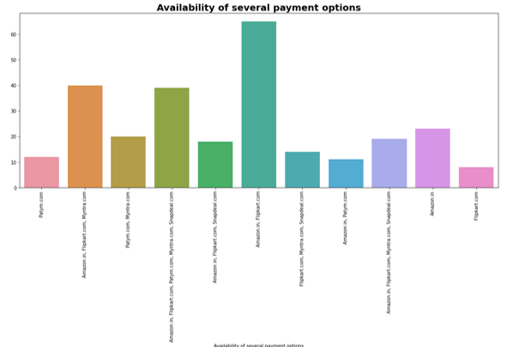
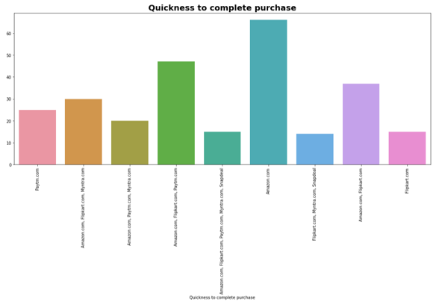
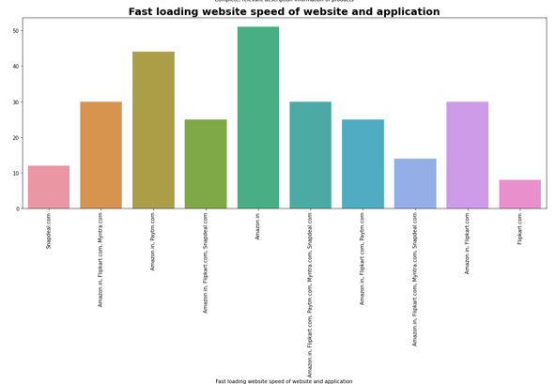
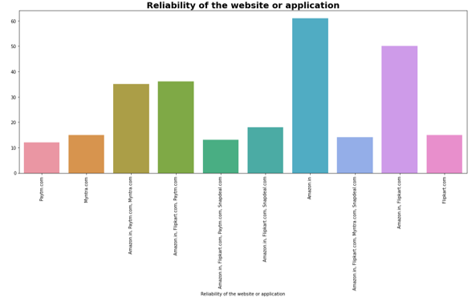

Slide 34
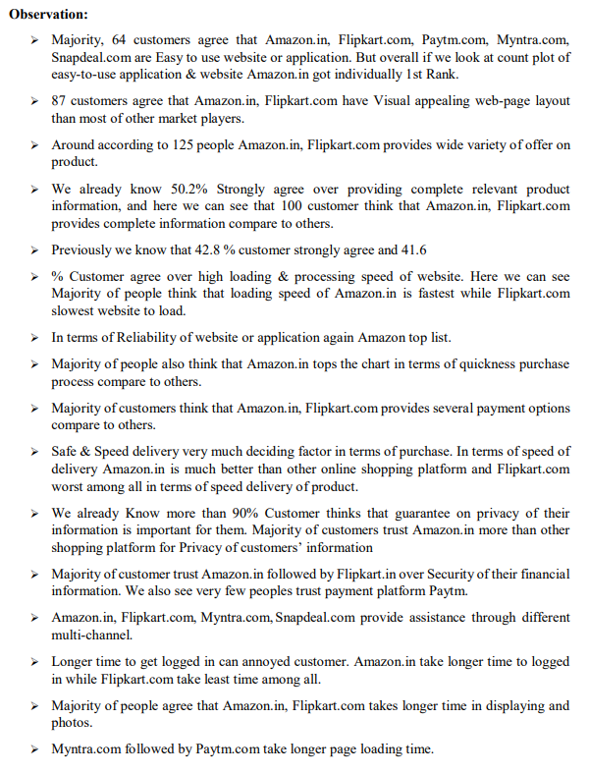
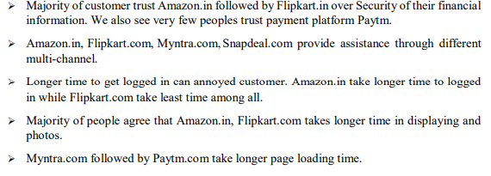
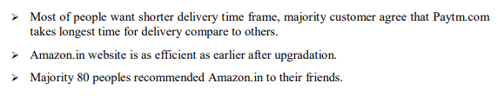

Slide 35
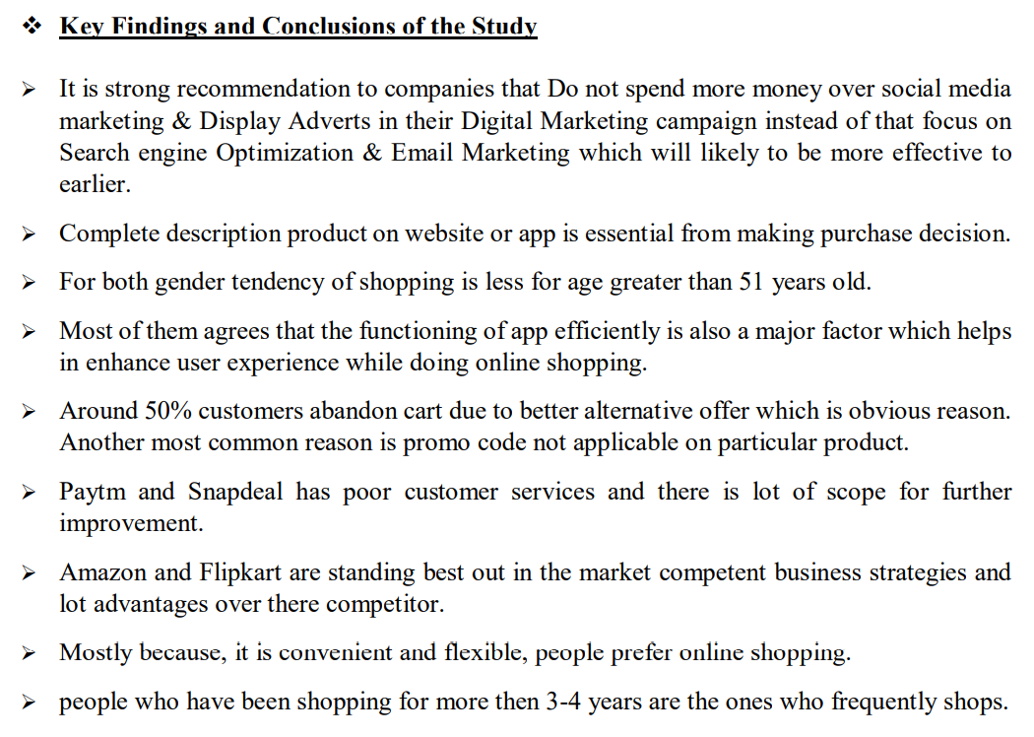
7. Conclusion

Slide 36
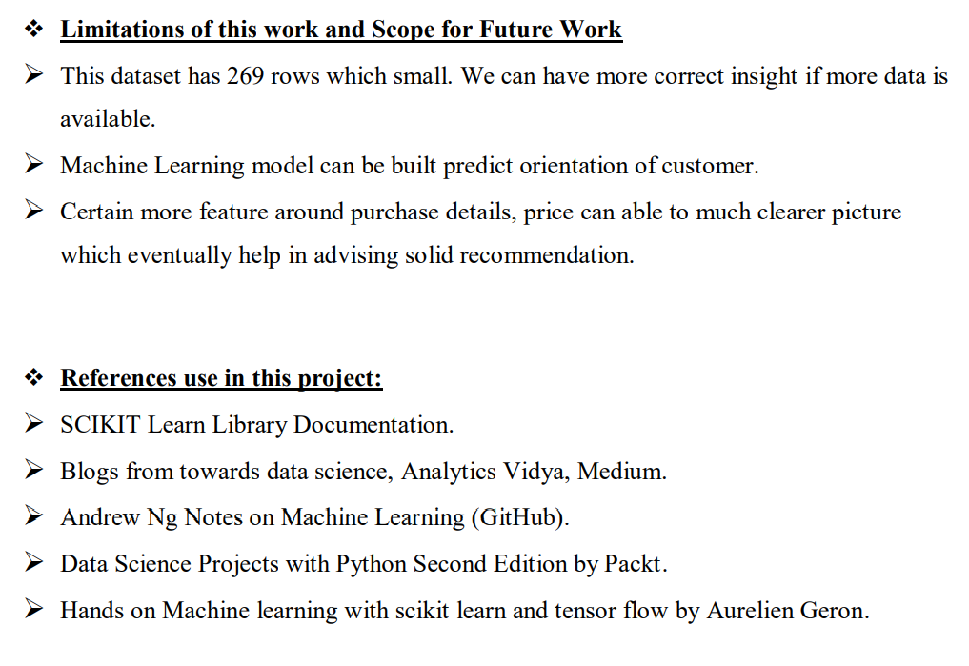

Slide 37


